Slide 1
Density
D = ?
M = 400 g
V = 4 mL
D = 3000 g/cm3
M = ?
V = 12 cm3
D = 45 g/mL
M = 10 g
V = ?

Slide 2
Unit 3
Work, Power, and Machines

Slide 3
Work
Work is done when a force acts on an object in the same direction the object moves.
Work requires motion!
No movement = no work
**Any part of the force that does not act in the direction of the motion does no work on the object.**

Slide 4
What's work?
Determine if each of the following is work.
1. A teacher pushes on a wall with the force of 100 N. The wall does not move :(
2. A book falls off a table and free falls to the ground.
3. A waiter carries a tray full of meals above his head by one arm straight across the room at constant speed.
4. A rocket accelerates through space.

Slide 5
Work
W
Formula
Work = Force x Distance
Unit
N * m = Joule (J)
When a force of 1 Newton moves an object 1 meter in the direction of force, 1 Joule of work is done.
F
D

Slide 6
How much work is done?
A oxen moves a plow 20-meters with 400 N of force. How much work is done?

Slide 7
Work Problems
1. How much force would have to be applied to produce 40 J of work over a distance of 10 meters?
2. What distance would an object be moved if 50 N of force was exerted on an object and 100 J of work was completed?
3. How much work was produced when an object was moved 300 meters with a force of 10 N exerted on it?

Slide 8
Power
Power
The rate of doing work
More power = faster work
Less power = slower work

Slide 9
Power Formula
W
Power = work / time
or
Power = Force * distance / time
Unit
Watt = 1 Joule / second
P
t

Slide 10
Power Conversion
:) Cool :)
A 40-watt light bulb requires 40 joules each second it is lit.
This amount of power is equal to lifting your textbook a height of one meter in half a second!

Slide 11
Power Work
1. A woman lifts a 300 newton child a distance of 1.5 meters in 0.75 seconds. What is her power output in lifting the child?
2. How much power does it take to lift 30.0 N 10.0 m high in 5.00 s?
3. You do 45 J of work in 3.0 seconds. How much power do you use?

Slide 12
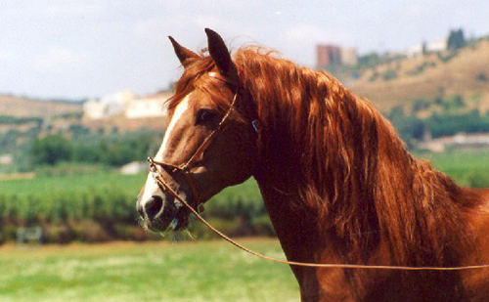
Horsing Around
James Watt (1736-1819) wanted a way to compare his steam engines to the work of a horse. He concluded that 1 horsepower is equal to approximately 746 watts.
= 746 watts

Slide 13
Clarification:
Power and Work

Slide 14
Science Starter: Tuesday
1. How much work is done when an 8 N force moves a block 7 meters?
2. How far will 490 J of work raise a block weighing 7 N?
3. How much power does it take to do 500 J of work in 10 seconds?

Slide 15
More work and power
1. Eva applies 40 N force to move her bookcase 3 m. How much work did Eva do?
2. Sheila did 110 J of work to move a chair 2 m to the right. How much force did Sheila use to move the chair?
3. How much power does it take to do 500 J of work in 10 s?
4. How much power does it take to lift 250 N, 40 m high in 2 seconds?
5. If it takes 20 N to move a box, how much power will be needed to move the box a distance of 5 meters in 5 seconds?
6. How much power does it take to lift 50 N 10 meters high in 10 seconds?
7. How long will it take a 100 W motor to lift a 5 kg mass 20 m?

Slide 19
Work and Machines
Machine:
A device that changes force
Requires energy to do work
Makes work easier to do
Like a car jack--
Little force applied on one end--
Big force on opposite side--

Slide 20
How do machines work?
1) Increase force
That car jack:
Small force exerted over a LONG distance (turning the crank) equals a large force over a SHORT distance (raising the car)

Slide 21
How do machines work?
2) Increase distance
Oars on a boat....
Decreases applied force, but applies the force to a greater area.

Slide 22
How do machines work?
3) Changing direction
Hey, the oar is a good example for this too!

Slide 23
Work input and output
***Memories***
What is friction?
Any force that opposes motion
How does this relate to machines?
Because of friction, the work done by a machine is always less than the work done on the machine.

Slide 24
What?
What is the definition of work?
No machine is 100% efficient...
There is always a tradeoff.
Less force --> More distance
More force --> Less distance
Work = force x distance

Slide 25
Work input
Input force
The force exerted on a machine
Input distance
The distance the input force acts through
Work input = input force x input distance
W_{i} = f_{i} x d_{i}
It is the work formula! But, for the work going into a task.

Slide 26
Work output
Output force
The force exerted by a machine
Output distance
The distance the output force is exerted through
Work output = output force x output distance
W_{o}= f_{o}x d_{o}
Hey, it's that work formula again!

Slide 27
Work output
All machines use some amount of input work to overcome friction!
No machine is 100% efficient...
The work in is always more than the work out.

Slide 28
Work Input and Work Output
1. In order to raise a 250 N bale of hay to the loft 3.0 m high you use a pulley that requires you to apply only 100 N of force but you have to pull 15 m of rope. Calculate the work input and work output.
2. You attempt to use a pry bar to pull out a 7.5 cm nail from a block of wood. You apply 30 N of force and you push the pry bar 30 cm. Calculate the work input.
3. You raise an 1800 N fridge 1.5 m high onto a truck bed. To do this you push it up a 10 m ramp and apply 500 N of force. Calculate the work input and work output.

Slide 29
Science Starter: Wednesday
1. In order to raise a 300 N bale of hay to the loft 3.0 m high you use a pulley that requires you to apply only 50 N of force but you have to pull 60 m of rope. Calculate the work input and work output.
2. You raise an 1800 N fridge 1.5 m high onto a truck bed. To do this you push it up a 10 m ramp and apply 500 N of force. Calculate the work input and work output.

Slide 30
Mini-Quiz
True/False (if false, make the statement true by changing the underlined term(s))
1. All machines are 100% efficient.
2. Input force is the force exerted on the machine.
3. List two of the three ways machines make work easier.
Calculate the following:
4. How far will 560 J of work raise a block weighing 8 N?
5. How much power does it take to do 600 J of work in 12 seconds?
6. How much power does it take to lift 120 N 6 meters high in 10 seconds?
Bonus (5-points): How many watts are in 1 horsepower? (INCLUDE UNITS FOR POINTS)

Slide 31
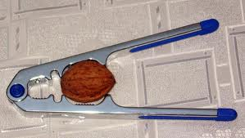
Mechanical Advantage and Efficiency
Mechanical Advantage
The number of times that the machine increases an input force

Slide 32
Actual Mechanical Advantage
Actual Mechanical Advantage (AMA) = Output force
Input force
Equals the ratio of the output force to the input force...
Includes FRICTION!!! Real world stuff!
A ramp decreases the input force...but, requires an input of a greater distance.

Slide 33
Ideal Mechanical Advantage
Ideal mechanical advantage (IMA) = Input distance
Output distance
Frictionless machine! (mwwwaahahahaha!)
Absence of friction--IDEAL!
Because friction is always present, the actual mechanical advantage of a machine is always LESS than the ideal mechanical advantage.

Slide 34
AMA versus IMA
1. What is the IMA of a 3.5 cm screw of which the threads measure 9.5 cm in length?
2. Calculate the AMA of a pulley attached to a 435-N load, but requiring only 75 N to operate.
3. What is the AMA of a lever created from a plank of wood and a paint can if a 1540-N boulder is lifted with only 225 N of force?
4. Calculate the IMA of a ramp that is 4.0 m long and 1.5 m high.

Slide 35
Efficiency
***No machine is 100% efficient***
Some of the work put into a machine is used to overcome friction---all the time---no exceptions--period.
***No machine is 100% efficient because some of the work put into a machine is used to overcome friction.***

Slide 36
Efficiency
A percentage
Efficiency = Work output
Work input
Comparison of the work going into a machine and the work coming out of a machine.
X 100%

Slide 37
Efficiency Problems
1. To pull a nail out of a wood board a carpenter does 1000 J of work. The hammer he uses does 835 J of work. What is the efficiency of the hammer?
2. A ramp is used to load furniture onto a moving truck. The person does 1240 J of work pushing the furniture up the ramp, and the ramp does 822 J of work. Calculate the efficiency of the ramp.
3. A lever does 765 J of work and the person using the lever applies 890 J of work. What is the efficiency of the lever?

Slide 38
Simple Machines
Six types of simple machines:
1. Lever
2. Wheel and axle
3. Inclined plane
4. Wedge
5. Screw
6. Pulley
Assignment--

Slide 39
Partners (2 people!)
1) What is your machine?
2) How does it make work easier?
3) Are there particular labeled parts of the machine?
4) How can you calculate ideal mechanical advantage?
5) Give two examples
6) Draw a picture
7) Make a mini-poster (color and stuff)
8) Post on back window

Slide 40
Lever
A rigid bar that is free to move around a fixed point.
Fixed point = fulcrum
Input arm = the distance between the input force and fulcrum
Output arm = the distance between the output force and the fulcrum
To calculate IMA of any lever, divide the input arm by the output arm.

Slide 41
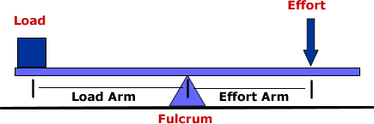
Lever parts
Three classes of levers (1st, 2nd, 3rd): Postion of fulcrum identifies class
Output Arm
Input Arm

Slide 42
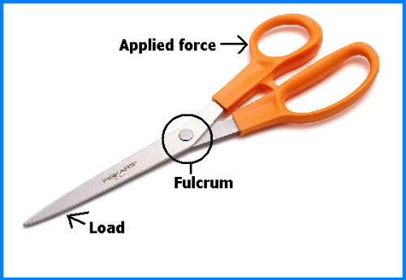
First Class Levers
Fulcrum located between the input force and output force
IMA: >1, = 1, or <1
Examples: Scissors, seesaw

Slide 43
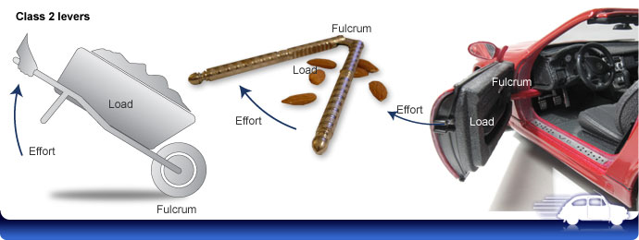
Second Class Levers
Output force located between the input force and fulcrum
IMA: >1
Examples: wheelbarrow, nutcracker , car door

Slide 44
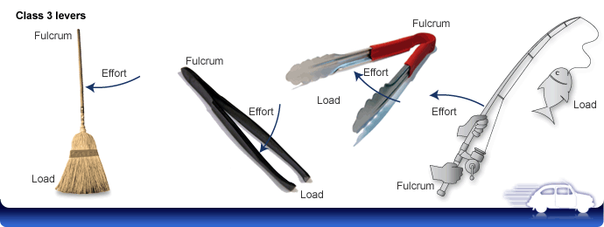
Third Class Levers
Input force located between the fulcrum and output force
IMA: <1
Example: Baseball bat, golf clubs

Slide 45
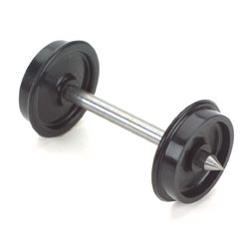
Wheel and Axle
Two disks or cylinders, each one with a different radius
Outer disk = wheel
Inner cylinder = axle
To calculate the IMA, divide the radius where the input force is exerted by the radius where the output force is exerted
IMA = >1 or <1

Slide 46
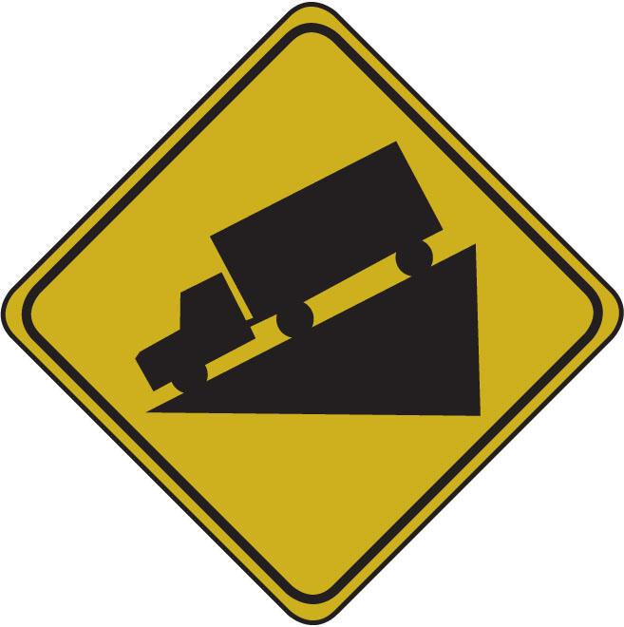
Inclined Plane
Slanted surface along which forces moves an object to different elevation.
The IMA is the distance along the inclined plane divided by its change in height.
Examples: Ramps!

Slide 47
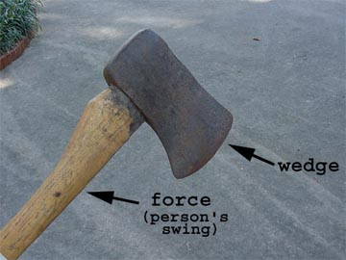
Wedge
V-shaped object whose sides are two inclined planes sloped toward each other.
A thin wedge of a given length has a greater IMA than a thick wedge of the same length.
Examples: knife blade, zipper

Slide 48
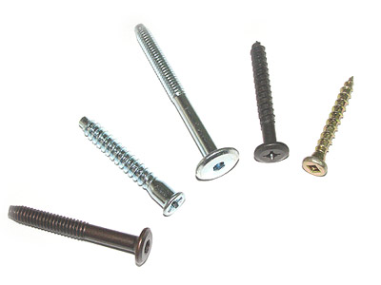
Screw
An inclined plane wrapped around a cylinder
Screws with threads that are closer together have a greater IMA.
Examples: Nuts and bolts, screws

Slide 49
Pulley
A simple machine that consists of a rope that fits into a groove in a wheel.
Output force is different in size, direction, or both from that of the input force.
IMA is equal to the number of rope sections supporting the load being lifted.
Three types: fixed, moveable, pulley system

Slide 50
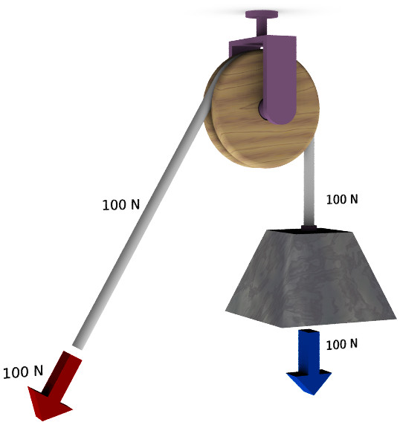
Fixed Pulley
Wheel is attached in a fixed location
Direction of exerted force is changed by a fixed pulley--not force
IMA = 1
If friction is small, input force and output force should be about equal.
Examples: Flagpole, blinds

Slide 51
Moveable Pulley
A pulley attached to the object being moved rather than to a fixed location.
Change both direction and size of input force
Examples: Sails on a ship, window washer lifts
https://www.youtube.com/watch?v=GPgTNCV0kTA

Slide 52
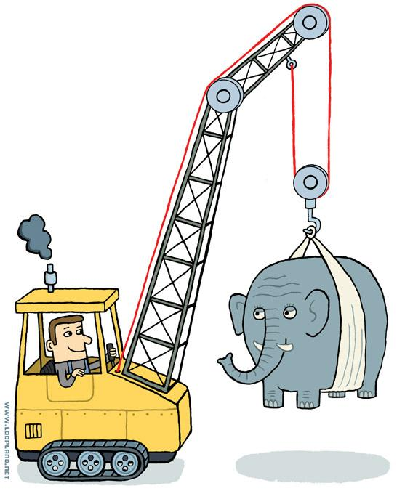
Pulley System
Combination of fixed and moveable pulleys
Large MA can be achieved!
Example: Cranes

Slide 53
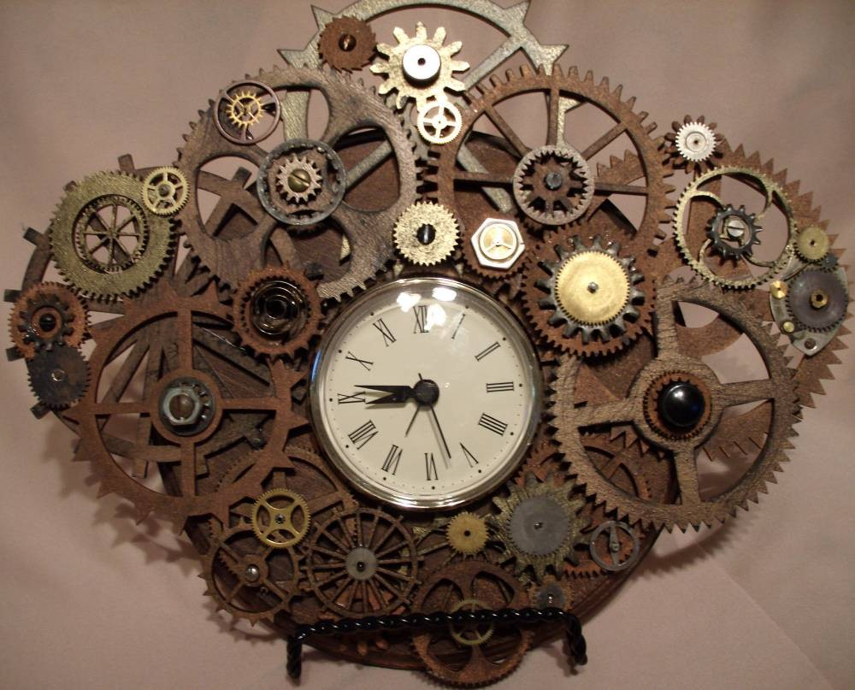
Compound Machines
A combination of two or more simple machines that operate together.
The output force of one simple machine is the input force of another.
Cars, clocks, etc.
Name some!

Slide 54
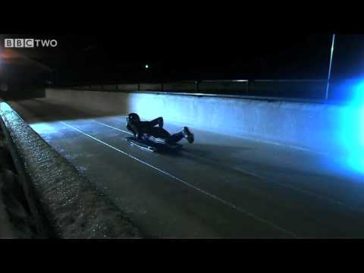
Bobsled versus Car

Slide 55
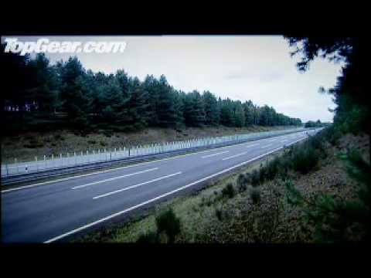
Bugatti Veyron-I shed a tear

