Slide 1
Waves

Slide 2
Science Starter
Thursday
1. What is the potential energy of a rock that weighs 100 N that is sitting on top of a hill 300 meters high?
2. What is the kinetic energy of a bicycle with a mass of 14 kg traveling at a velocity of 3 m/s?

Slide 3
Mechanical Waves
Mechanical Waves
Disturbance in matter that carries energy from one place to another
Medium
Material through which the wave travels
Can be solid, liquid, or gas!

Slide 4
Mechanical Waves
Mechanical waves are created when a source of energy causes a vibration to travel through a medium
Vibration: back and forth motion!
Examples...

Slide 5
Types of Mechanical Waves
Transverse waves
Longitudinal or compressional waves
Surface waves

Slide 6
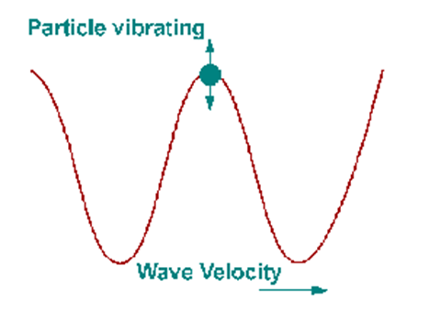
Transverse Waves
The motion of the medium is at right angles to the direction of the wave...
What is a right angle?
90 degrees or perpendicular

Slide 7
Transverse Waves
Examples:
Ribbon twirling, guitar strings, and the wave

Slide 8
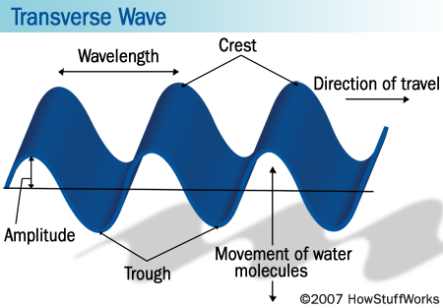
Transverse Waves
Crest
Highest point above rest position
Trough
Lowest point below rest

Slide 9
Longitudinal or Compressional Waves
Movement of the medium is in the same direction as, or the opposite direction to, the motion of the wave

Slide 10
Longitudinal Waves
Compression
An area where the particles in a medium are spaced close together
Rarefraction
An area where the particles in a medium are spread out

Slide 11
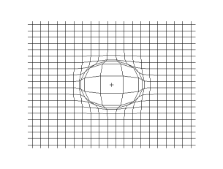
Longitudinal Waves
Also called compression waves
Examples:
Spring, primary waves (earthquakes--first waves to arrive)

Slide 12
Surface Waves
Wave that travels along a surface separating two media
Most surface waves do not transport matter from one place to another
Across the surface of the object, not through it

Slide 13
Surface Waves

Slide 14
Surface Waves
Examples: ocean waves, Love and Rayleigh waves (earthquakes--the ones that do damage)

Slide 16
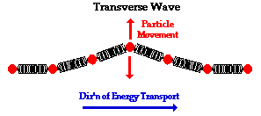
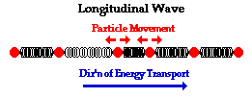
Comparing Waves

Slide 17
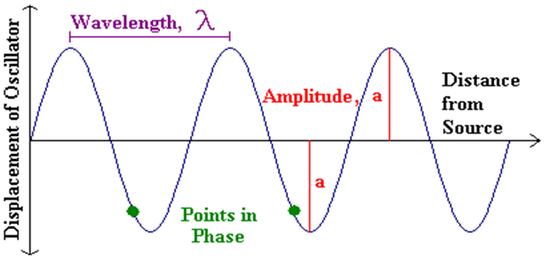
Properties of Mechanical Waves

Slide 18
Frequency and Period
Periodic motion
any motion that repeats at regular time
Period
the time required for one cycle
Frequency
number of complete cycles in a given time
measured in hertz (Hz)

Slide 19
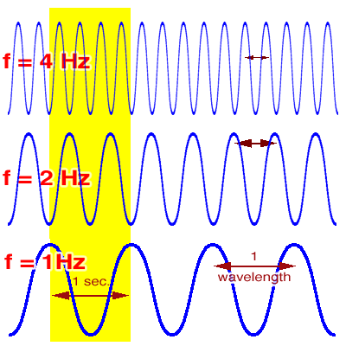
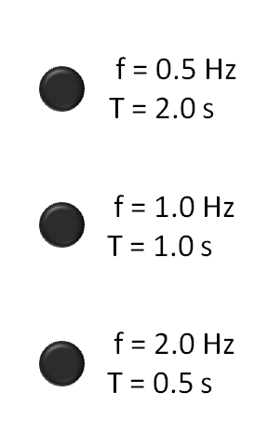
Frequency and Period
A wave's frequency equals the frequency of the vibrating source producing the wave

Slide 20
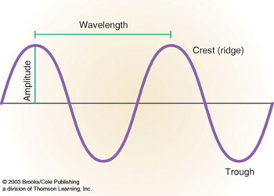
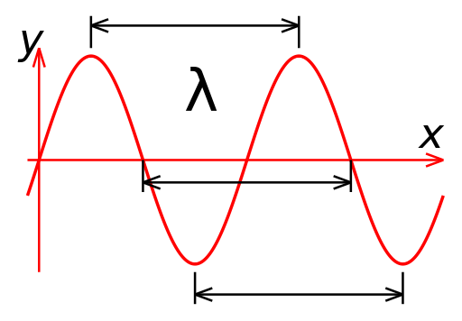
Wavelength
The distance between a point on one wave and the same point on the next cycle of the wave
Unit: meters!
Symbol: lambda λ
Increasing the frequency of the wave decreases its wavelength

Slide 21
Wave Speed
Speed = Wavelength x Frequency
Units: meters per second (m/s)
Go to page 506, Math Practice, 1 and 2

Slide 22
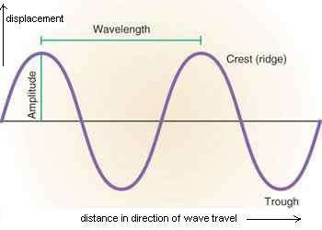
Amplitude
Maximum displacement of the medium from its rest position...
MORE energy --> GREATER amplitude

Slide 23
Behavior of Waves
Five groups
1st period
2nd period
4th period
You will be group teaching---

Slide 24
Groups
One: Reflection
Two: Refraction
Three: Diffraction
Four: Interference
Five: Standing waves

Slide 25
Stuff at your disposal--
Poster board
Crayons, colored pencils, markers
Books
Worksheets
Lab stuff
Whatever you need to teach!
YOU HAVE 20-minutes to PREPARE!

Slide 26
Sound Waves
Sound waves are longitudinal waves
Properties of Sound Waves
Speed
Intensity and loudness
Frequency and pitch

Slide 27
Speed
...of sound
342 meters per second
or
761 miles per hour
Travels fastest in solids, slower in liquids, and slowest in gases
Depends on density and elasticity of medium

Slide 28
Speed

Slide 29
Intensity and Loudness
Intensity
the rate at which a wave's energy flows through a given area
Depends on wave's amplitude AND distance from the sound source
Whisper in the ear versus across the room

Slide 30
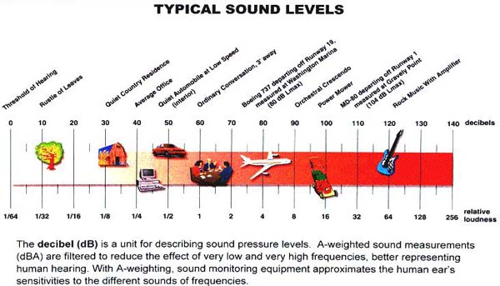
Intensity and Loudness
Measured in decibels (dB)
Loudness
Physical response to the intensity of sound
My left ear versus right ear :(

Slide 31
Frequency and Pitch
Pitch
Frequency of a sound as you perceive it
Depends of wave's frequency!
High frequency = high pitch
Low frequency = low pitch
High pitch sounds usually impaired first--

Slide 32
Hearing Test

Slide 33
Ultrasound
Human hearing between 20 Hz and 20,000 Hz
Infrasound--sound produced at frequencies lower than most people can hear
Ultrasound--sound produced at frequencies higher than most people can hear
SONAR and ultrasound imaging

Slide 34
SONAR
SOund Navigation And Ranging
Uses sound propagation for navigation
Used widely during WWI and WWII
Echos!
Some animals are evolved with this ability!

Slide 35
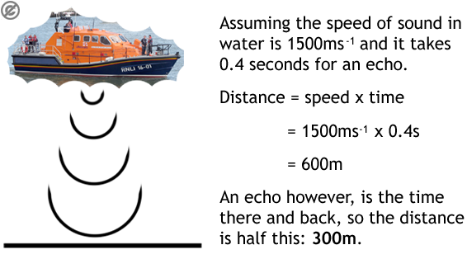
SONAR
Ocean floor video

Slide 36
Ultrasound Imaging

