Slide 1
Unit 3
Energy

Slide 2
Energy and its Forms
Energy is the ability to do work
Energy is needed to exert a force over a distance in order to move an object.
Unit: Joules (J) -- Same as WORK!
WORK is the transfer of ENERGY!
Objects can gain energy because work is being done on them.

Slide 3
Types of Mechanical Energy
Kinetic Energy
Potential Energy
Gravitational potential energy
Elastic potential energy

Slide 4
Kinetic Energy (KE)
Energy an object has due to its motion
KE = 1/2mv²
Unit: Joules (
Dependent upon MASS and VELOCITY.
)

Slide 5
Potential Energy (PE)
Energy that is stored as a result of position or shape.
PE --> KE --> PE
Two types:
Gravitational
Elastic

Slide 6
Gravitational Potential Energy (PE_{g})
Energy stored in an object as the result of its vertical position or height (gravity)
The result of gravitational attraction
Dependent upon mass of object and height to which it is raised
Direct relationship between PE and mass
Direct relationship between PE and height of an object

Slide 7
Gravitational Potential Energy (PE_{g})
Acceleration due to gravity is 9.8 m/s²!
Gravitational potential energy = mass * gravity * height
PE_{g} = m * g * h

Slide 8
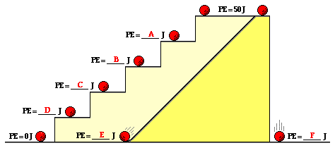
Calculating PE_{g}
Since the PEg of an object is directly proportional to its height above the zero position, a doubling of the height will result in a doubling of the gravitational potential energy.

Slide 9
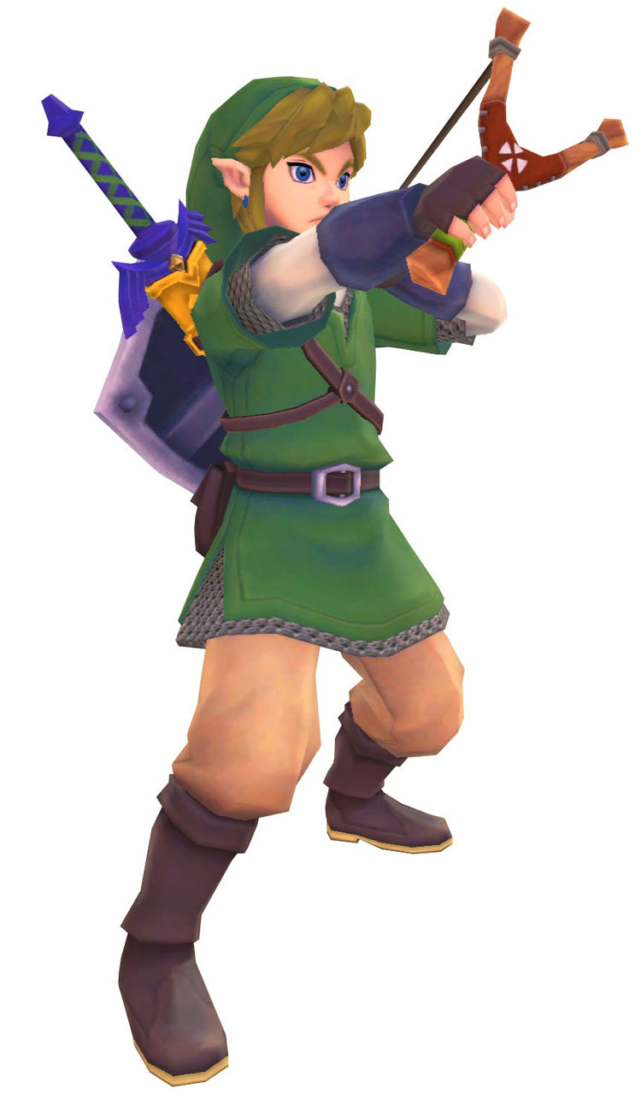
Elastic Potential Energy
Energy stored in elastic materials as the result of their stretching or compressing
The more stretch or compression, the more potential energy!

Slide 10
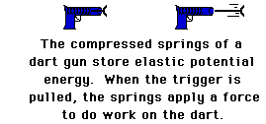
Elasitc Potential Energy

Slide 11
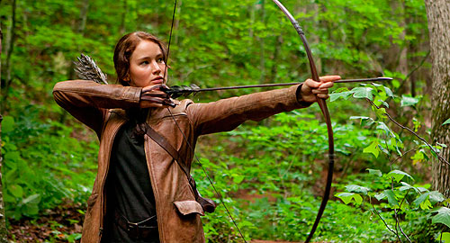
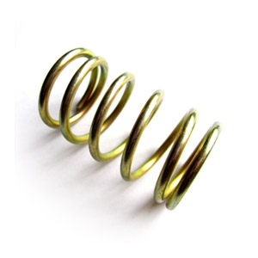
Elastic Potential Energy

Slide 12
Kinetic Energy (KE)
Moving energy
If an object is moving it has kinetic energy
KE = 1/2mv²
Why would tripling the speed at which a car is moving have a greater effect on its kinetic energy than tripling its mass?

Slide 13
Kinetic Energy--Answer
KE = 1/2mv²
Kinetic energy is directly proportional to mass, but it is proportional to the square of the object's speed.

Slide 14
Kinetic Energy: Problems :)
1. Calculate the kinetic energy of a 45 g golf ball travelling at: a) 20 m/s, b) 40 m/s c) 60 m/s
(hint: need to convert mass)
2. A 4 kg rock is rolling 10 m/s. Find its KE.
3. An 8 kg cat is running 4.0 m/s. What is its KE?

Slide 15
PE_{g} Practice
1. In 1993, Cuban athlete Javier Sotomayor set the world record for the high jump. The gravitational potential energy associated with Sotomayor’s jump was 1970 J. Sotomayor’s mass was 82.0 kg. How high did Sotomayor jump?

Slide 16
PE_{g} Practice
2. An 1750 kg weather satellite moves in a circular orbit with a gravitational potential
energy of 1.69 × 10¹⁰ J. At its location, free-fall acceleration is only 6.44 m/s2. How
high above Earth’s surface is the satellite?

Slide 17
PE_{g} Practice
3. With an elevation of 5334 m above sea level, the village of Aucanquilca, Chile is the
highest inhabited town in the world. What would be the gravitational potential energy
associated with a 64 kg person in Aucanquilca?

Slide 18
PE_{g} Practice
4. The Royal Gorge Bridge is situated 321 m above the Arkansas River in Colorado. If
the gravitational potential energy associated with a tourist on the bridge is 1.73 × 10⁵ J
with respect to the river, what is the tourist’s mass?

Slide 19
Forms of Energy
Mechanical
Thermal
Chemical
Electrical
Electromagnetic (Radiant & Solar)
Nuclear
Cellular

Slide 20
Science Starter: Wednesday
Matching
1. Potential Energy a. equals m*a_{g}*h
2. Kinetic Energy b. a slingshot
3. Gravitational PE c. equals 0.5mv²
4. Elastic PE d. stored energy

Slide 21
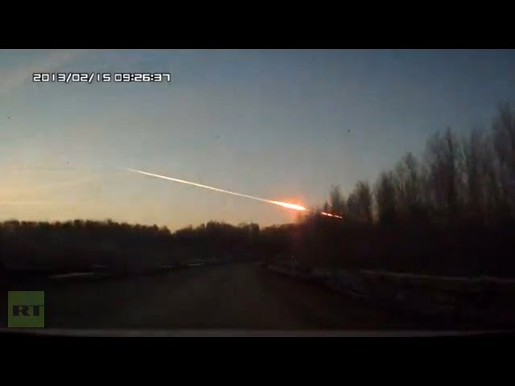
Section 15.2:
Energy Conversion and Conservation

Slide 22
Energy Conservation
Law of Conservation
Energy cannot be created or destroyed
It changes into other forms...
ENERGY CONVERSION
Mechanical -- Thermal -- Chemical -- Electrical -- Electromagnetic -- Nuclear

Slide 23
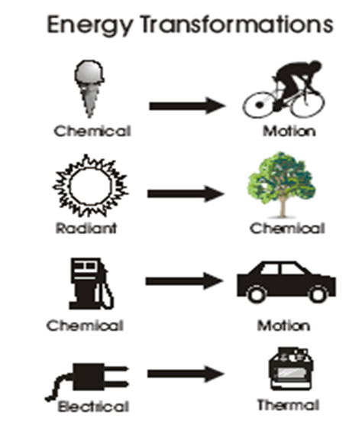
Energy Conversion
Give me three more examples!!!
Reminder: Mechanical Thermal Chemical
Electrical Electromagnetic Nuclear

Slide 24
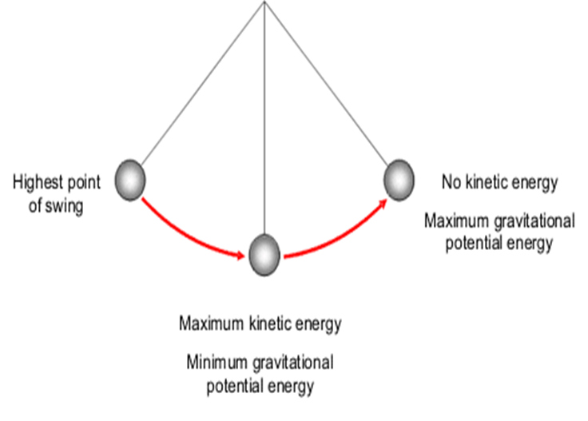
Pendulums

Slide 25
Energy Conversion Calculations
Mechanical Energy = KE + PE
(KE + PE)_{beginning} = (KE + PE)_{end}

Slide 26
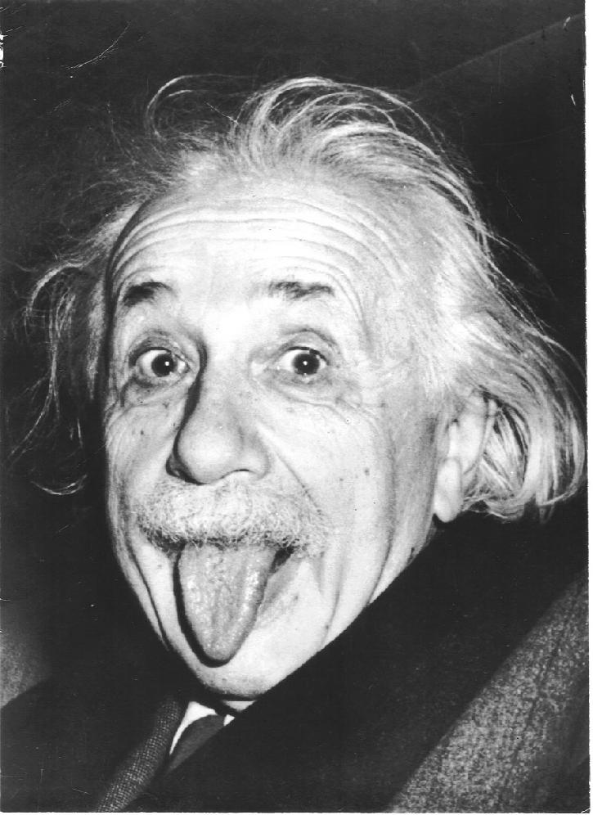
Energy and Mass
E = mc²
E = energy
m = mass
c = constant (speed of light, 3.0 x 10⁸ m/s or 186,000 miles per second
Energy and mass can be converted into each other

Slide 27
45 minutes
Finish Unit 2 Test if you have not finished it.
Look at Missing Assignments List to see if you have missing assignments (0)
Get the assignment you are missing off the back bench
If you are missing notes or notebook pages, get those! They are located on the back bench in the folders (Intro, Unit 1, Unit 2). Unit 1 Test needs to be completed on a Scantron.
IT IS YOUR RESPONSIBILITY TO DO THIS.
After you are completed, study vocabulary terms

