Slide 1
The Electromagnetic Spectrum

Slide 2
Electromagnetic Waves
Electromagnetic waves (EM)
Transverse waves consisting of changing electric fields and changing magnetic fields

Slide 3
Electromagnetic Waves
Do not need a medium---
Mechanical waves require a medium---CANNOT travel through the vacuum of space
Electromagnetic waves do not require a medium---CAN travel through the vacuum of space

Slide 4
Electromagnetic Waves
EM waves have different frequency and wavelengths but they all travel at the same velocity.
Velocity:
3.0 x 10⁸ m/s
or
186,000 miles per second

Slide 5
The Electromagnetic Spectrum
Energy increases with increased frequency.
**Remember: Visible light is just one small part of the EM spectrum. Visible light is the part that our eyes can detect.**

Slide 6
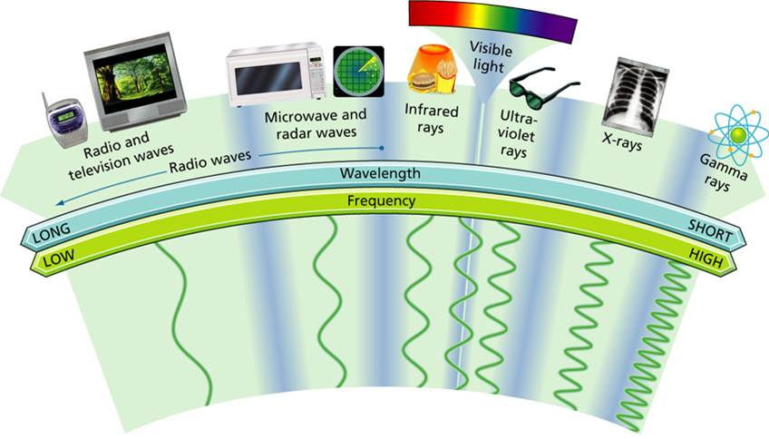

Slide 7
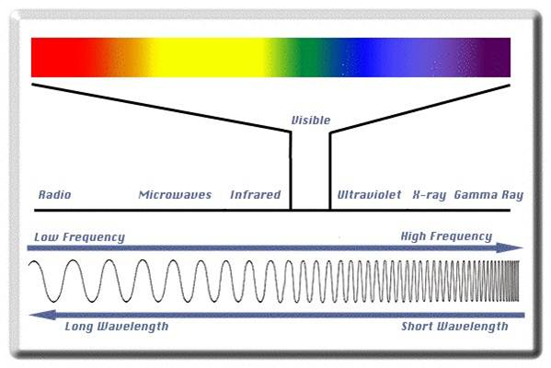

Slide 8
